Slide 1
S-127 and S-101 Data Model and digital route service
John Morten Klingsheim
senior engineer
Norwegian Coastal Administration Region West,
Senter for pilotage and VTS 31th January 2019

Slide 2
84.1) S-127 and S-101 Data Model
Digital Route Service with reference to Digital Coastal Pilot
Suggested amendments, S-127 and S-101 Data Model

Slide 3
NCSR 6/8 Flow chart for the development of a new Maritime Service
Development of S-100 Feature Catalogues based on descriptions of the relevant services

Slide 4
NCSR 6/8 Interaction between development of Maritime Services – Technical Services and Data Models.

Slide 5
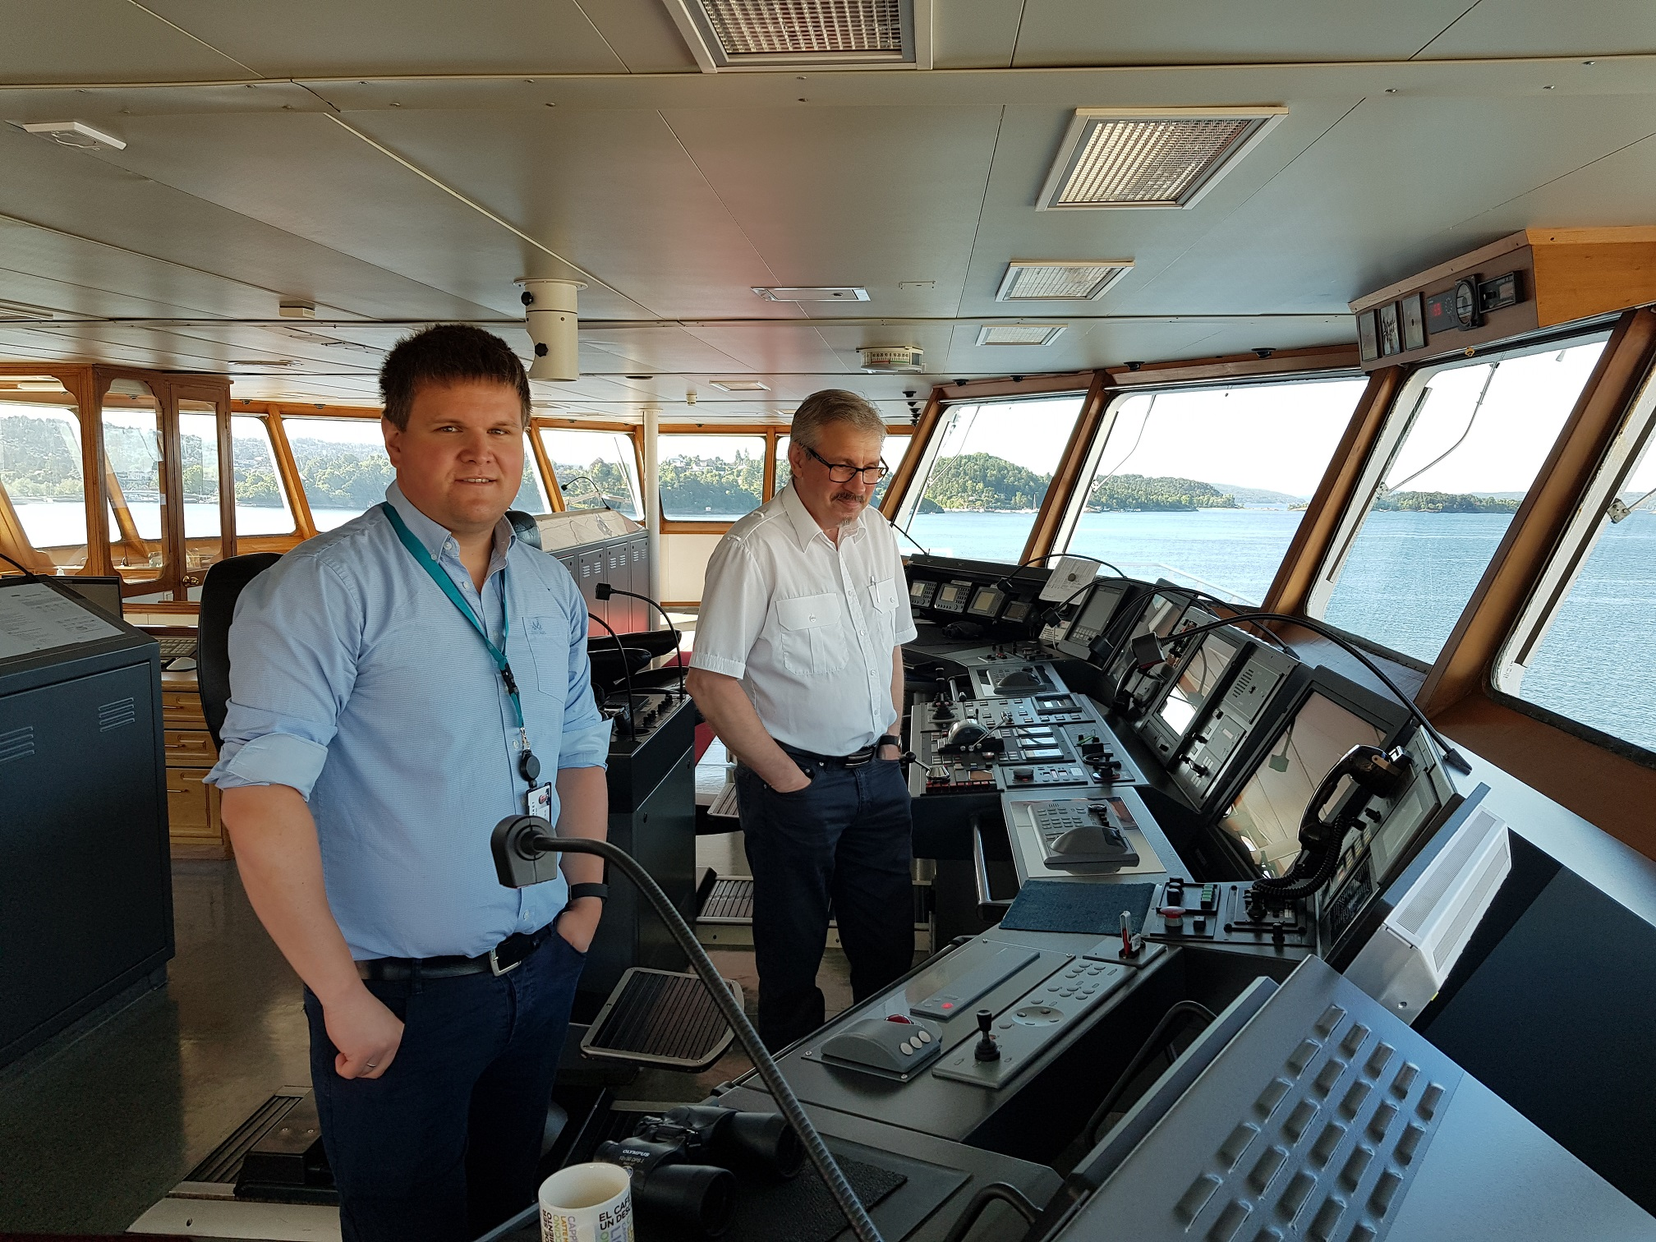
Most information is connected to a place, to put it on the map increase the value a lot
There is a large pull from the navigators and other usergroups to get relevant information, efficient anc cheap

Slide 6
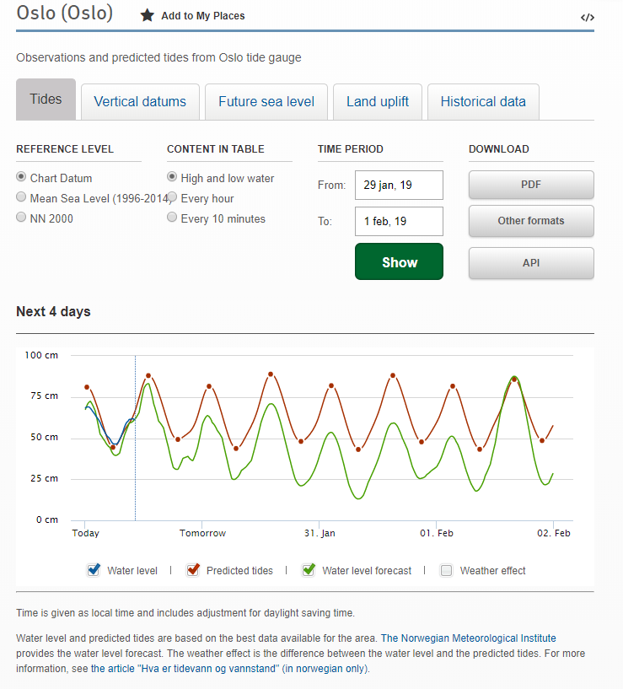
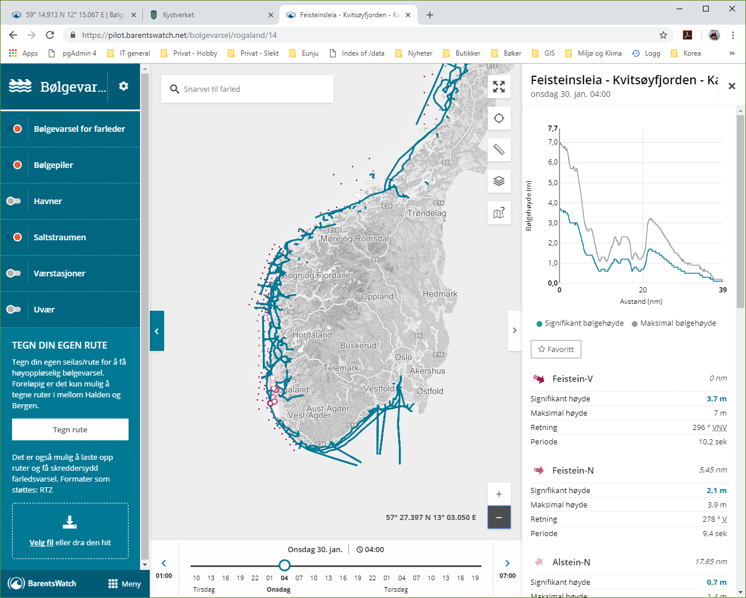
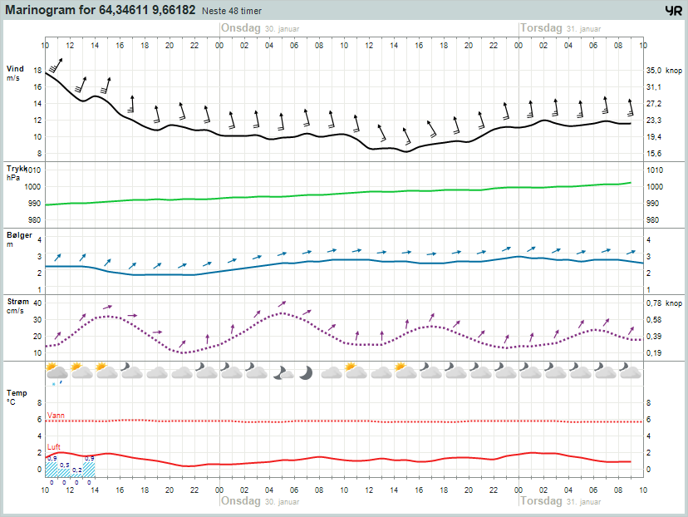
Most information is connected to a place, to put it on the map increase the value a lot
There is a large pull from the navigators and other usergroups to get relevant information, efficient anc cheap
Also none-IHO bathymetry

Slide 7
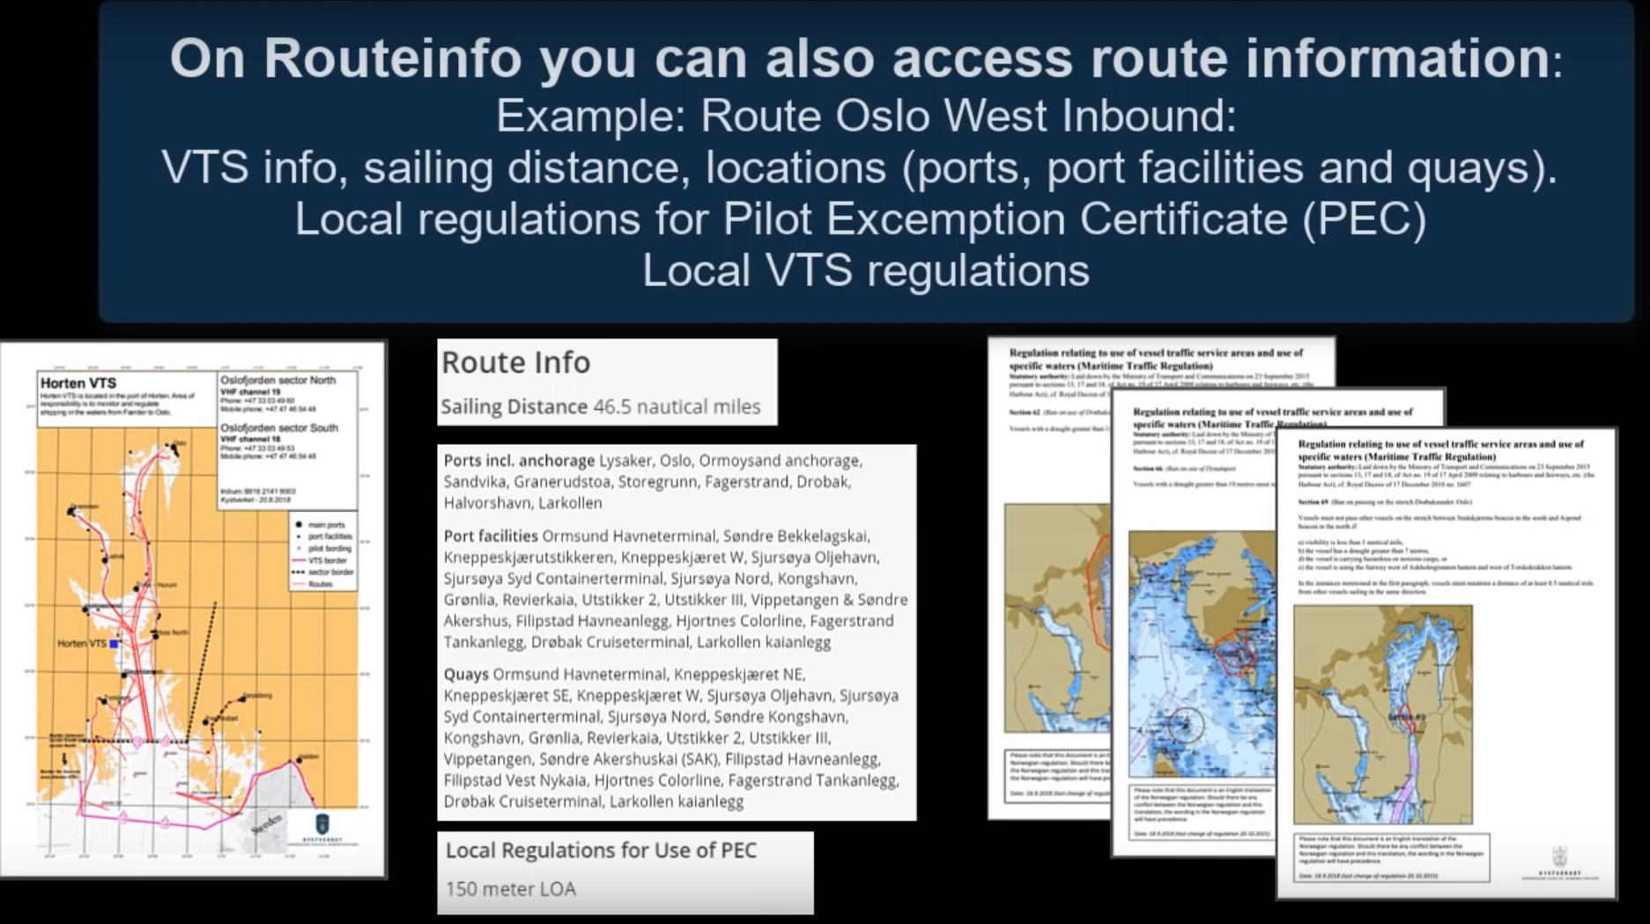
Digital Route Service based on IEC 61174:2015 (RTZ v. 1.0)
Recommended routes
+ Route information
Locations:
Ports (SafeSeaNet Norway including places at sea and Anchorages
Port facilities (NCA’s register of ISPS port facilities)
Quay’s.: registered in SafeSeaNet Norway by the ports)
Regulations not available in nav.chart/ENC:
PEC (Pilot Excemption Certificate)
VTS (within service areas for Vessel Traffic Centers)
VTS Factsheet
Sailing distance

Slide 8
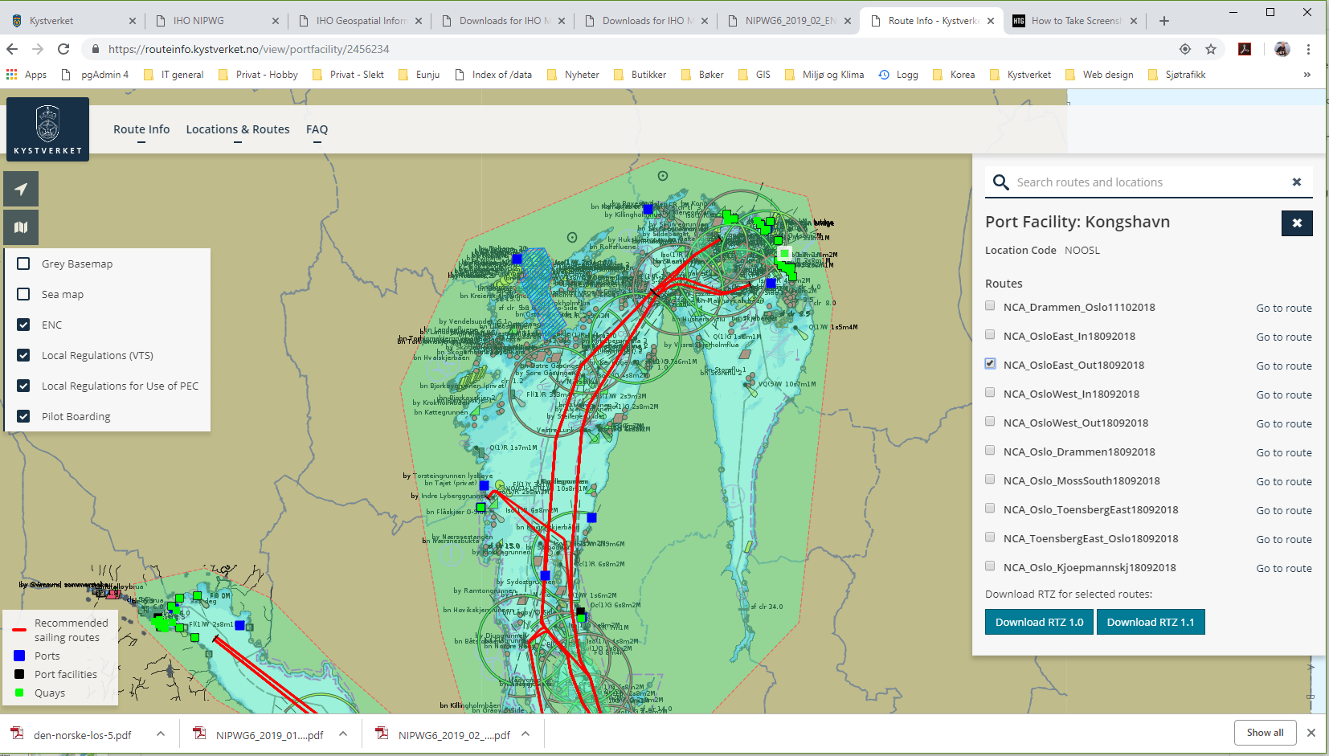
Traffic Managament Recommended Route Test in Oslo-area https://routeinfo.kystverket.no

Slide 9
Technical solution –Recommended routes (RTZ 1.0/1.1)

Slide 10
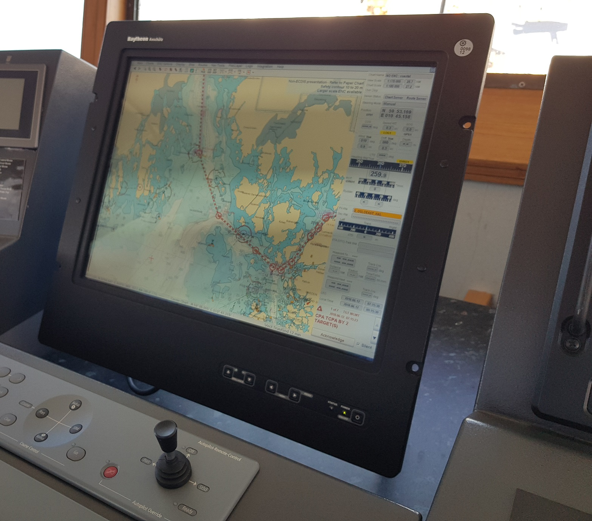
Test September - December 2018 (navigator, pilot, VTS)
Test goals:
To assure the routes comes up on navigation platforms in a good way.
To check any file-format issues.
To assure that the service gives the wanted support to navigation.
To establish grounds for seamless update of recommended routes on vessels.
PS: NCA today has not infrastructure for route exchange!
From the testing:
File name longer than 25 signs can cause problems on some ECS.
«validityPeriodStart» and «validityPeriodStop» seems not to mean nothing in some navigation platforms.
Only the file name is easily accessible for the navigator. Other route information quite hidden. Waypoints of course easy accesible.
Route uploaded on I-pad sometinmes stored automaticly with file extension xml.

Slide 11
Data model challenges (RTZ 1.0):
- Need to include unique id for a route relevante for many voyages. Unique ID in RTZ refer to unique voyages.
- Seamless update out to the vessel ECDIS/Planning station, when a recommended route is updated.

Slide 12
Marine Traffic Management. See Paper for Consideration by NIPWG – Data Model Amendments on S-127 and S-101.
Info from Nautical Institute on VTS-services:
https://www.nautinst.org/download.cfm?docid=C0AEA172-EA66-4727-B3AA01DB3BEBE286

Slide 13
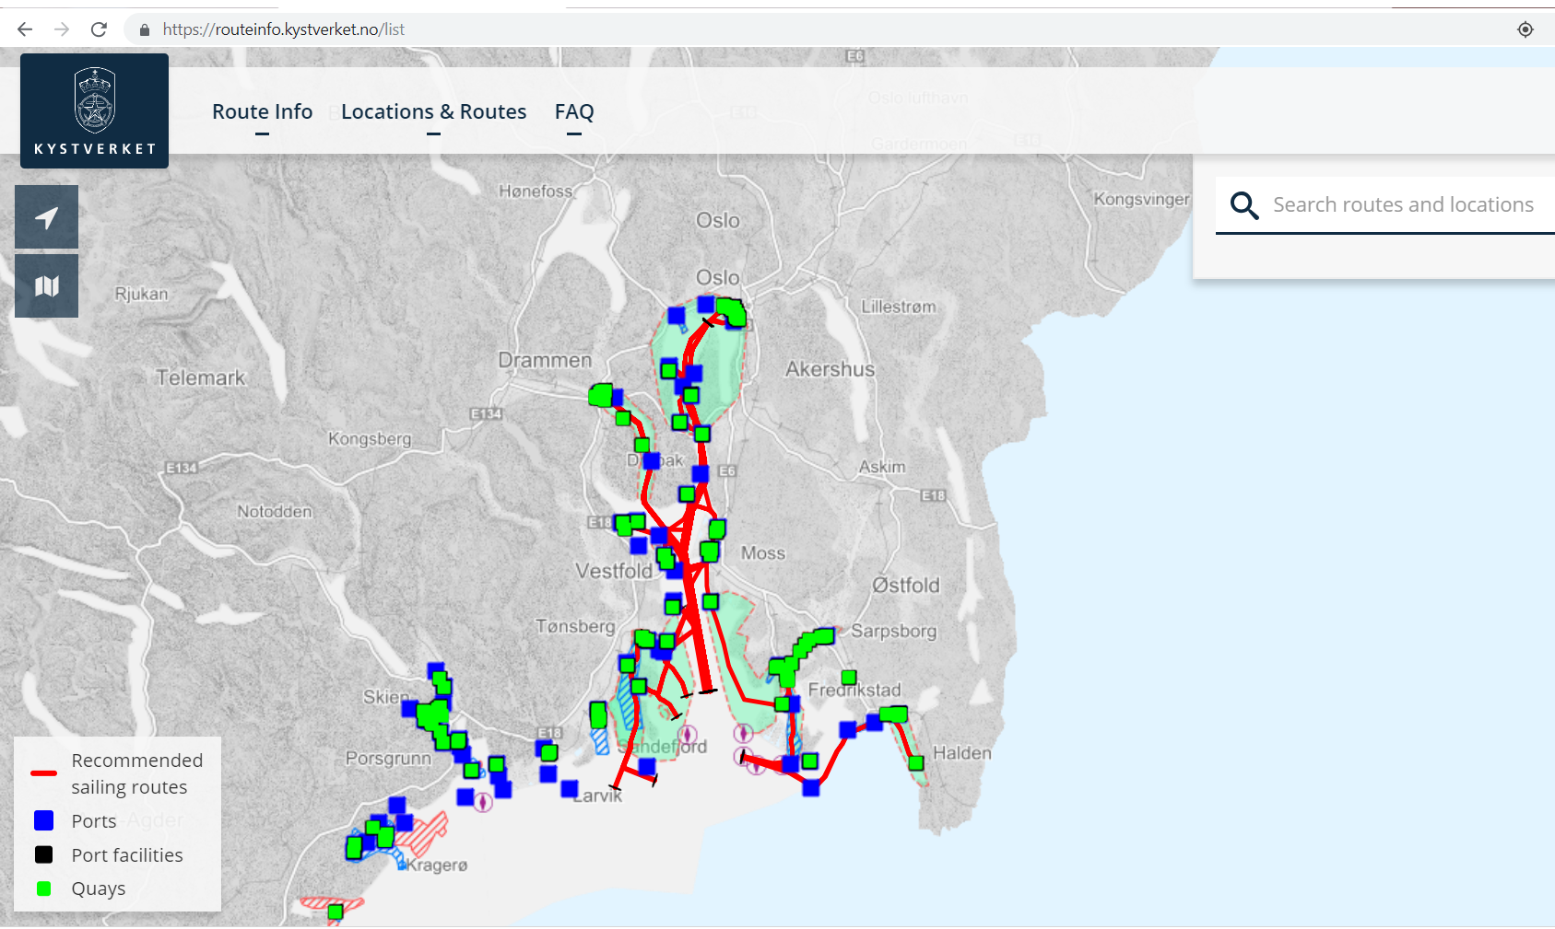
Demo / Video
https://www.youtube.com/watch?v=266FF5ETThQ

Slide 14
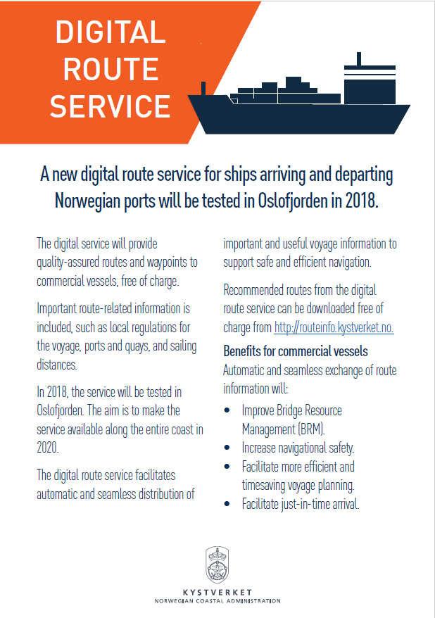
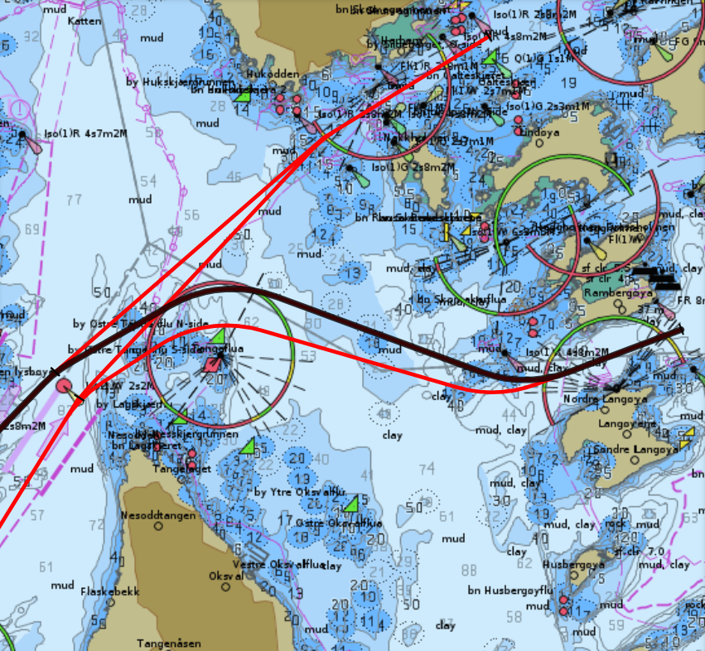
Thanks!
jmk@kystverket.no

